Slide 1

Doubly Linked Lists
Sanjeev Ghosh
Associate Professor, E&TC

Slide 2

Introduction
A Doubly Linked List is an advanced version of Singly Linked List which has an additional pointer prev to store the location of the previous node.
A Doubly Linked list is also made up of nodes, but as compared to the node used in Singly linked list, node in case of doubly linked list has 3 parts:
Data Part: Holds the data
Prev Address Part: Holds the address of the previous node.
Next Address Part: Holds the address of the next node.

Slide 3
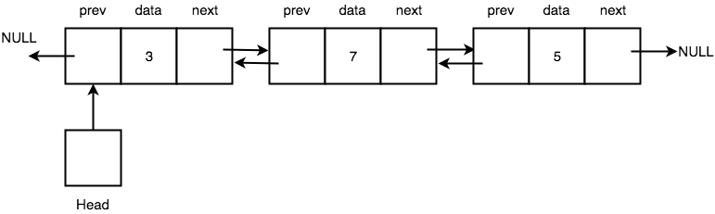
Doubly Linked Lists
Below we have a simple pictorial representation of Nodes connected to form a Doubly Linked List.

Slide 4
Doubly Linked Lists
As you can see, every node has some data stored in it, and it also stores the location of the next node and the previous node.
It is not necessary that all the nodes get saved in contiguous memory locations.
Also, the first node's prev pointer and the last node's next pointer points to NULL because there is no node before the first node and after the last node.
Head is a pointer which always points to the first node of the list, if Head points to nothing, it means the linked list is empty.

Slide 5
Advantages
Advantages of a Doubly Linked List over a Singly Linked List.
We can traverse a Doubly Linked List in both forward and backward directions.
Also, when we must delete any node in a Singly Linked List, we must declare an additional pointer to keep track of the previous node, which is not required in case of Doubly Linked List.

Slide 6
Disadvantages
The major disadvantage is maintaining an extra prev pointer
Demands extra memory space
Adds extra steps to carry out basic operations on the Doubly Linked list
update two pointers every time we insert a new node or delete a node.

Slide 7
Implementation
To implement a Doubly Linked List, we will first define a class for Node which will have three attributes, namely data, prev and next
next is the pointer to store the location of the next node
prev is the pointer to store the location of the previous node.
# Node of a doubly linked list
class Node:
def __init__(self, data):
self.data = data
self.next = None
self.prev = None

Slide 8
Creating the Doubly Linked List Class
class DoublyLinkedList:
#Represent the head and tail of the doubly linked list
def __init__(self):
self.head = None;
self.tail = None;

Slide 9
Doubly Linked List display() method
display() will show all the nodes present in the list.
Algorithm
Define a new node 'current' that will point to the head.
Print current.data till current points to null.
Current will point to the next node in the list in each iteration.

Slide 10
Creating the Doubly Linked List Class
class DoublyLinkedList:
#Represent the head and tail of the doubly linked list
def __init__(self):
self.head = None;
self.tail = None;
#display() will print out the nodes of the list
def display(self):
#Node current will point to head
current = self.head;
if(self.head == None):
print("List is empty");
return;
print("Nodes of doubly linked list: ");
while(current != None):
#Prints each node by incrementing pointer.
print(current.data),;
current = current.next;

Slide 11
Creating the Doubly Linked List Class
dList = DoublyLinkedList();
#Displays the nodes present in the list
dList.display();

Slide 12
Adding a Node addNode() method
addNode() will add node to the list:
Algorithm
It first checks whether the head is null, then it will insert the node as the head.
Both head and tail will point to a newly added node.
Head's previous pointer will point to null and tail's next pointer will point to null.
If the head is not null, the new node will be inserted at the end of the list such that new node's previous pointer will point to tail.
The new node will become the new tail. Tail's next pointer will point to null.

Slide 13
addNode() method
def addNode(self, data):
#Create a new node
newNode = Node(data);
#If list is empty
if(self.head == None):
#Both head and tail will point to newNode
self.head = self.tail = newNode;
#head's previous will point to None
self.head.previous = None;
#tail's next will point to None, as it is the last node of the list
self.tail.next = None;
else:
#newNode will be added after tail such that tail's next will point to newNode
self.tail.next = newNode;
#newNode's previous will point to tail
newNode.previous = self.tail;
#newNode will become new tail
self.tail = newNode;
#As it is last node, tail's next will point to None
self.tail.next = None;

Slide 14
Adding Nodes to the Doubly Linked List
dList = DoublyLinkedList();
#Add nodes to the list
dList.addNode(1);
dList.addNode(2);
dList.addNode(3);
dList.addNode(4);
dList.addNode(5);
#Displays the nodes present in the list
dList.display();

Slide 15
Adding Nodes to the Doubly Linked List
A node can be added in four ways
At the front of the DLL
After a given node.
At the end of the DLL
Before a given node.

Slide 16
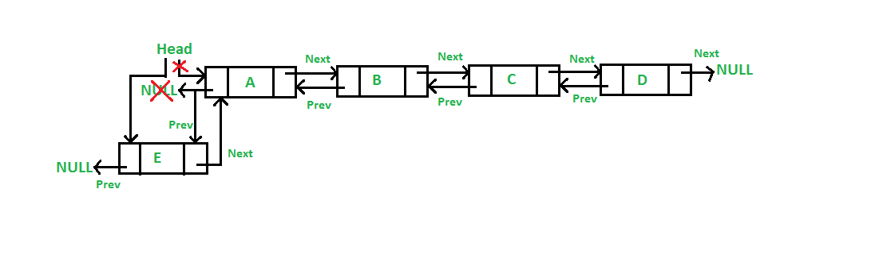
Add a node at the front:

Slide 17
Add a node at the front push() method
def push(self, data):
#1 & 2 Create a new node
newNode = Node(data);
#If list is empty
if(self.head == None):
#Both head and tail will point to newNode
self.head = self.tail = newNode;
#head's previous will point to None
self.head.previous = None;
#tail's next will point to None, as it is the last node of the list
self.tail.next = None;
else:
# 3. Make next of new node as head and previous as NULL
newNode.next = self.head
newNode.previous = None
# 4. change prev of head node to new node
if self.head is not None:
self.head.previous = newNode
# 5. move the head to point to the new node
self.head = newNode

Slide 18
Adding Nodes to the Doubly Linked List
dList = DoublyLinkedList();
#Add nodes to the list
dList.addNode(1);
dList.addNode(2);
dList.addNode(3);
dList.addNode(4);
dList.addNode(5);
#Displays the nodes present in the list
dList.display();
# Add node at the beginning of the list
dList.push(6)
#Displays the nodes present in the list
dList.display()

Slide 19
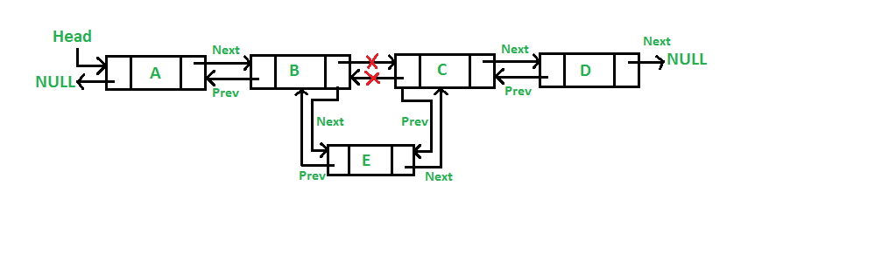
Add a node after a given node

Slide 20
Add a node after a given node
Algorithm
check if the given prev_node is NULL
allocate node &
put in the data
Make next of new node as next of prev_node
Make the next of prev_node as new_node
Make prev_node as previous of new_node
Change previous of new_node's next node

Slide 21
Add a node after a given node: insertAfter() method
def insertAfter(self, prevNode, data):
# 1. check if the given prev_node is NULL
if prevNode is None:
print("This node doesn't exist in DLL")
return
#2. allocate node & 3. put in the data
newNode = Node(data)
# 4. Make next of new node as next of prev_node
newNode.next = prevNode.next
# 5. Make the next of prev_node as new_node
prevNode.next = newNode
# 6. Make prev_node as previous of new_node
newNode.prev = prevNode
# 7. Change previous of new_node's next node */
if newNode.next is not None:
newNode.next.prev = newNode

Slide 22
Add a node after a given node
dList = DoublyLinkedList();
#Add nodes to the list
dList.addNode(1);
dList.addNode(2);
dList.addNode(3);
dList.addNode(4);
dList.addNode(5);
#Displays the nodes present in the list
dList.display();
# Add node at the beginning of the list
dList.insertAfter(dList.head.next, 13)
#Displays the nodes present in the list
dList.display()

Slide 23
Add a node after a given node
In the previous method, we couldn’t specify the exact node after which we want to insert our data
We need an alternative method to achieve that
In order to do this, we need an additional method get_node()

Slide 24
get_node() method
get_node() takes an index as argument and traverses the list from the first node that many times to return the node at that index.
def get_node(self, index):
current = self.head
for i in range(index):
if current is None:
return None
current = current.next
return current

Slide 25
Add a node after a given node using the get_node() method
def insertAfter(self, position, data):
newNode = Node(data)
index = int(position)
ref_node = self.get_node(index)
if ref_node.next is None:
self.tail = newNode
else:
newNode.next = ref_node.next
newNode.next.prev = newNode
ref_node.next = newNode

Slide 26
Add a node after a given node
dList = DoublyLinkedList();
#Add nodes to the list
dList.addNode(1);
dList.addNode(2);
dList.addNode(3);
dList.addNode(4);
dList.addNode(5);
#Displays the nodes present in the list
dList.display();
# Add node at the beginning of the list
dList.insertAfter(2, 13)
#Displays the nodes present in the list
dList.display()

Slide 27
Deleting a node
Like insertion, there can be multiple ways to delete elements from a doubly linked list.
Deleting Elements from the Start
Deleting Elements from the End
Deleting Elements by position

Slide 28
Deleting a node by position
The method remove() takes a node as argument and removes it from the list.

Slide 29
Deleting a node by position remove() method
def remove(self, position):
index = int(position)
node = self.get_node(index)
if node is None:
print('No such index.')
return
elif node.prev is None:
self.head = node.next
self.head.prev=None
elif node.next is None:
node.prev = None
self.tail=node.prev
else:
node.prev.next = node.next
node.next.prev=node.prev

Slide 30
Deleting a node by position remove() method
dList = DoublyLinkedList();
#Add nodes to the list
dList.addNode(1);
dList.addNode(2);
dList.addNode(3);
dList.addNode(4);
dList.addNode(5);
#Displays the nodes present in the list
dList.display();
# remove a node
dList.remove(2)
#Displays the nodes present in the list
dList.display()

Slide 31
Doubly Linked List Traversal
def searchNode(self, value):
i = 1;
flag = False;
#Node current will point to head
current = self.head;
#Checks whether the list is empty
if(self.head == None):
print("List is empty");
return;
while(current != None):
#Compare value to be searched with each node in the list
if(current.data == value):
flag = True;
break;
current = current.next;
i = i + 1;
if(flag):
print("Node is present in the list at the position : " + str(i));
else:
print("Node is not present in the list");

Slide 32
Traversing a DLL by the searchNode() method
dList = DoublyLinkedList();
#Add nodes to the list
dList.addNode(1);
dList.addNode(2);
dList.addNode(3);
dList.addNode(4);
dList.addNode(5);
#Displays the nodes present in the list
dList.display();
# remove a node
dList.searchNode(2)

Slide 33

Stack using Linked List

Slide 34
Stack using Linked List
Instead of using array, we can also use linked list to implement stack.
Linked list allocates the memory dynamically.
In linked list implementation of stack, the nodes are maintained non-contiguously in the memory.
Each node contains a pointer to its immediate successor node in the stack.

Slide 35
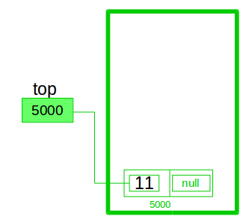
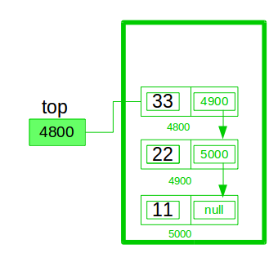
Stack using Linked List
In stack Implementation, a stack contains a top pointer
It is called the “head” of the stack where pushing and popping items happens
first node has null in link field and second node link has first node address in link field and so on and
The “top” pointer has last node address

Slide 36

Stack using Linked List
The main advantage of using linked list over an arrays is that it is possible to implement a stack that can shrink or grow as much as needed.
Stack implementation using array puts a restriction to the maximum capacity of the array which can lead to stack overflow.
Here each new node will be allocated memory dynamically.

Slide 37

Stack Operations:
push() : Insert the element into linked list nothing but which is the top node of Stack.
pop() : Return top element from the Stack and move the top pointer to the second node of linked list or Stack.
display(): Print all elements of Stack.

Slide 38

Implementation
class Node:
# Class to create nodes of linked list
# constructor initializes node automatically
def __init__(self,data):
self.data = data
self.next = None
class Stack:
# head is default NULL
def __init__(self):
self.head = None

Slide 39
Adding a node to the stack (Push operation)
Adding a node to the stack is referred to as push operation.
Algorithm
Create a node first and allocate memory to it.
If the list is empty, then the item is to be pushed as the head node of the list. This includes assigning value to the data part of the node and assign null to the address part of the node.
If there are some nodes in the list already, then we must add the new element in the beginning of the list (to not violate the property of the stack). For this purpose, assign the address of the starting element to the address field of the new node and make the new node, the starting node of the list.

Slide 40
Adding a node to the stack using the Push() method
def push(self,data):
if self.head == None:
self.head=Node(data)
else:
newnode = Node(data)
newnode.next = self.head
self.head = newnode

Slide 41
Deleting a node from the stack (POP operation)
Deleting a node from the top of stack is referred to as pop operation.
Algorithm
Check for the underflow condition: The underflow condition occurs when we try to pop from an already empty stack. The stack will be empty if the head pointer of the list points to null.
Adjust the head pointer accordingly: In stack, the elements are popped only from one end, therefore, the value stored in the head pointer must be deleted and the node must be freed. The next node of the head node now becomes the head node.

Slide 42
Underflow condition isempty() method
# Checks if stack is empty
def isempty(self):
if self.head == None:
return True
else:
return False

Slide 43
Deleting a node from the stack using the pop() method
# Remove element that is the current head (start of the stack)
def pop(self):
if self.isempty():
return None
else:
# Removes the head node and makes the preceding one the new head
poppednode = self.head
self.head = self.head.next
poppednode.next = None
return poppednode.data

Slide 44
Display the nodes (Traversing)
Displaying all the nodes of a stack needs traversing all the nodes of the linked list organized in the form of stack.
Algorithm
Copy the head pointer into a temporary pointer.
Move the temporary pointer through all the nodes of the list and print the value field attached to every node.

Slide 45
Display the nodes (Traversing)
# Prints out the stack
def display(self):
iternode = self.head
if self.isempty():
print("Stack Underflow")
else:
while(iternode != None):
print(iternode.data)
iternode = iternode.next
return

Slide 46
Code for creating and displaying a stack
MyStack = Stack()
MyStack.push(11)
MyStack.push(22)
MyStack.push(33)
MyStack.push(44)
# Display stack elements
MyStack.display()
# Delete top elements of stack
MyStack.pop()
MyStack.pop()
# Display stack elements
MyStack.display()

Slide 47

Queue using Linked List

Slide 48

Queue using Linked List
Array implementation can not be used for the large-scale applications where the queues are implemented.
One of the alternative of array implementation is linked list implementation of queue.

Slide 49
Queue using Linked List
In a linked queue, each node of the queue consists of two parts i.e. data part and the link part.
Each element of the queue points to its immediate next element in the memory.

Slide 50
Queue using Linked List
In the linked queue, there are two pointers maintained in the memory i.e. front pointer and rear pointer.
The front pointer contains the address of the starting element of the queue while the rear pointer contains the address of the last element of the queue.
Insertion and deletions are performed at rear and front end respectively.
If front and rear both are NULL, it indicates that the queue is empty.

Slide 51
Queue using Linked List
1. Create a class Node with instance variables data and next.
2. Create a class Queue with instance variables head and last.
3. The variable head points to the first element in the linked list while last points to the last element.
4. Define methods enqueue and dequeue inside the class Queue.
5. The method enqueue adds a node at the end of the linked list.
6. The method dequeue returns the data of the node at the front of the linked list and removes the node. It returns None if there are no nodes.

Slide 52
Queue using Linked List
class Node:
def __init__(self, data):
self.data = data
self.next = None
class Queue:
def __init__(self):
self.head = None
self.last = None

Slide 53
Queue using Linked List enqueue() method
def enqueue(self, data):
if self.last is None:
self.head = Node(data)
self.last = self.head
else:
self.last.next = Node(data)
self.last = self.last.next

Slide 54
Queue using Linked List dequeue() method
def dequeue(self):
if self.head is None:
return None
else:
to_return = self.head.data
if self.head.next is None:
self.last = None
self.head = self.head.next
return to_return

Slide 55
Code for creating and displaying a queue
q = Queue()
q.EnQueue(10)
q.EnQueue(20)
q.DeQueue()
q.DeQueue()
q.EnQueue(30)
q.EnQueue(40)
q.EnQueue(50)

Slide 56
Applications of Linked Lists
Implementation of stacks and queues
Implementation of graphs : Adjacency list representation of graphs is most popular which is uses linked list to store adjacent vertices.
Dynamic memory allocation : We use linked list of free blocks.
Maintaining directory of names
Performing arithmetic operations on long integers

Slide 57
Applications of linked list in real world
Image viewer – Previous and next images are linked, hence can be accessed by next and previous button.
Previous and next page in web browser – We can access previous and next url searched in web browser by pressing back and next button since, they are linked as linked list.
Music Player – Songs in music player are linked to previous and next song. you can play songs either from starting or ending of the list.

Slide 58

Thank You

